Slide 1

Modelling and Control of Renewable Energy
ENEE 504
Design a photovoltaic (PV) system for a house
Presented by:
Mohamed motawea
Youssef elsebaie
Abdelrahman elkhouly
Ali wael
INTRODUCTION

Slide 2



TABLE OF CONTENTS
1) The design steps
2) Simulation on PVsyst
3) The wiring diagram
4) Cost analysis
5) Effect of shading

Slide 3
Design steps
Specifying the loads
Orientation of PV panels
designing a standalone PV system
choosing a battery
choosing a DC controller
choosing an inverter

Slide 4
Specifying the Loads
Appliance | No. | Total energy (Watt Hour)
Lamps | 11 | 2299
Chargers (for phones, laptops, headphones | 9 | 855
AC | 2 | 15000
Fridge | 2 | 3460
Router | 2 | 576
Electric water heater | 1 | 2250
Kettle | 1 | 550
Microwave | 1 | 600
Domestic appliances | 1 | 250
Washing machine | 1 | 3000

Slide 5
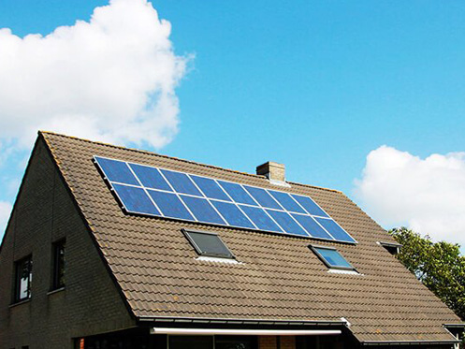
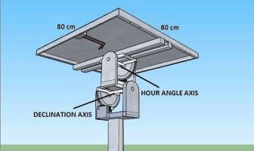
Orientation of PV panel
Final Exam
40%
Project 40%
Midterm Exam 20%
Seasonal tilting PV panel
2-axis tracker PV panel

Slide 6

PV module sizing
SPV module total wattage: 10674 W/ Wp
configuration: 4-string, 5-series
SC current: 57.2 A
OC voltage: 274 V

Slide 7
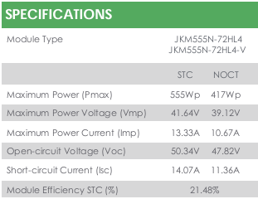
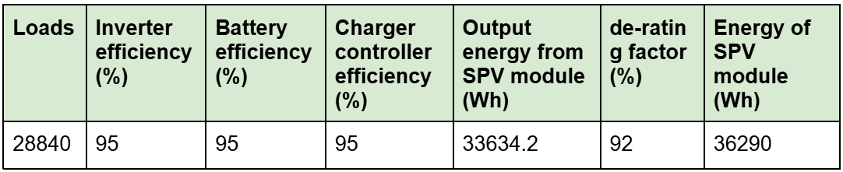
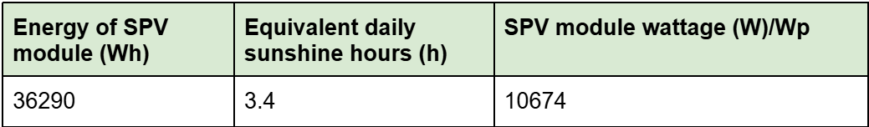
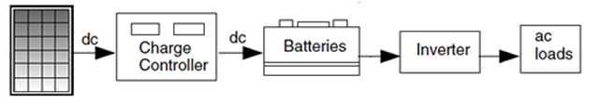
PV module sizing

Slide 8
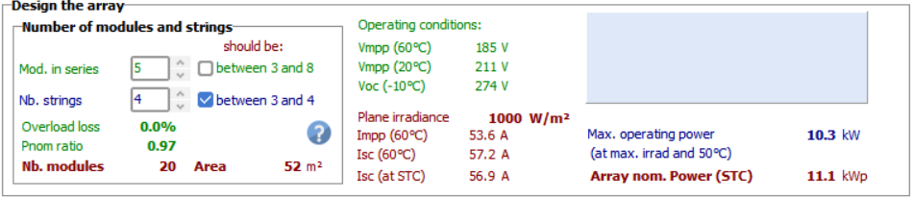
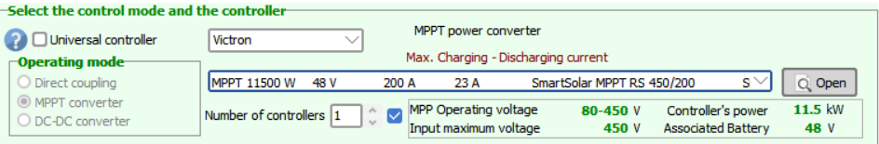
PV module sizing
Total number of PV modules is 20 (4*5) array Occupying an area of 52m^2 (within our roof constraints -> 303m^2)
Compatible with the charger controller:

Slide 9
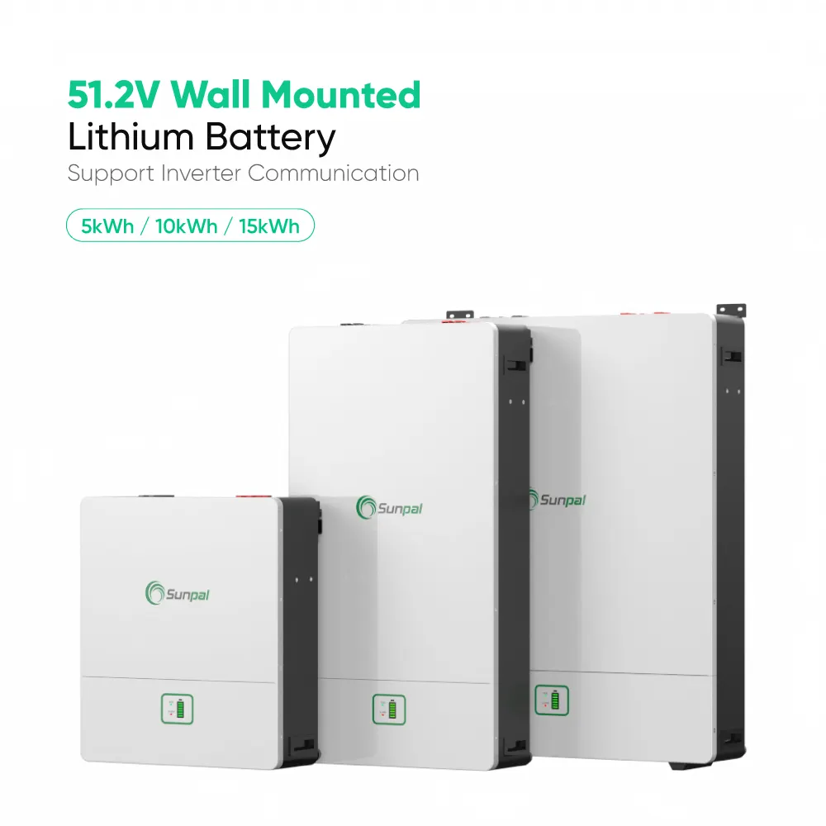
The battery
the single module parameters: 48V 200Ah
the battery configuration: 1S8P
the total energy: 76800Wh

Slide 10
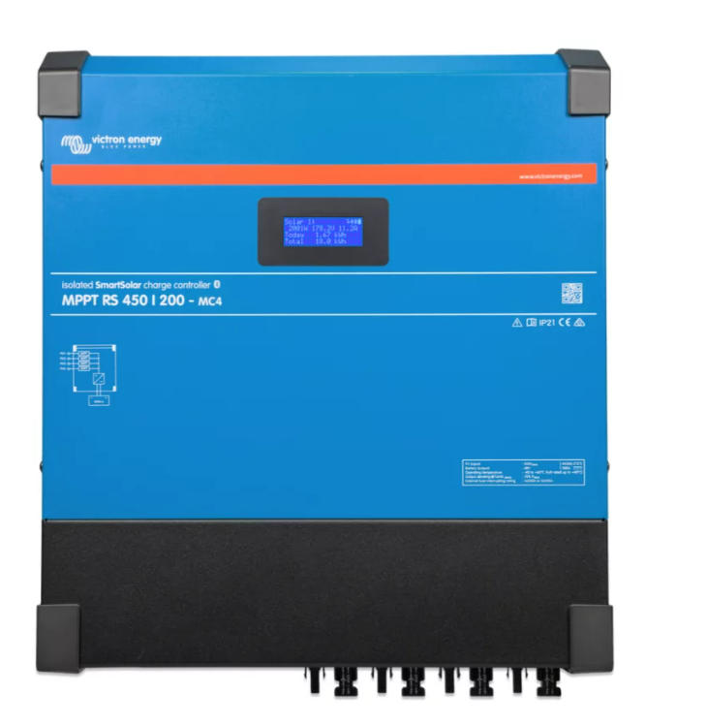
DC controller
SmartSolar MPPT RS 450|200 - Isolated 11.52 kW Solar Charge Controller with 450 V PV input

Slide 11
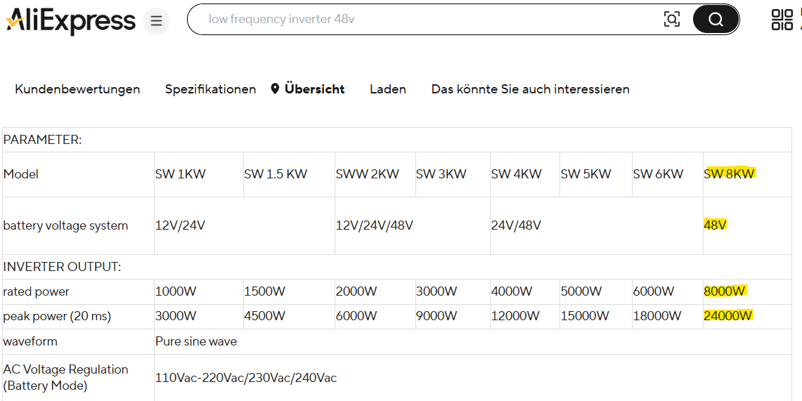
The inverter
the max demand power: 4210 W
the system voltage : 48V
the system current: 87.7A

Slide 12
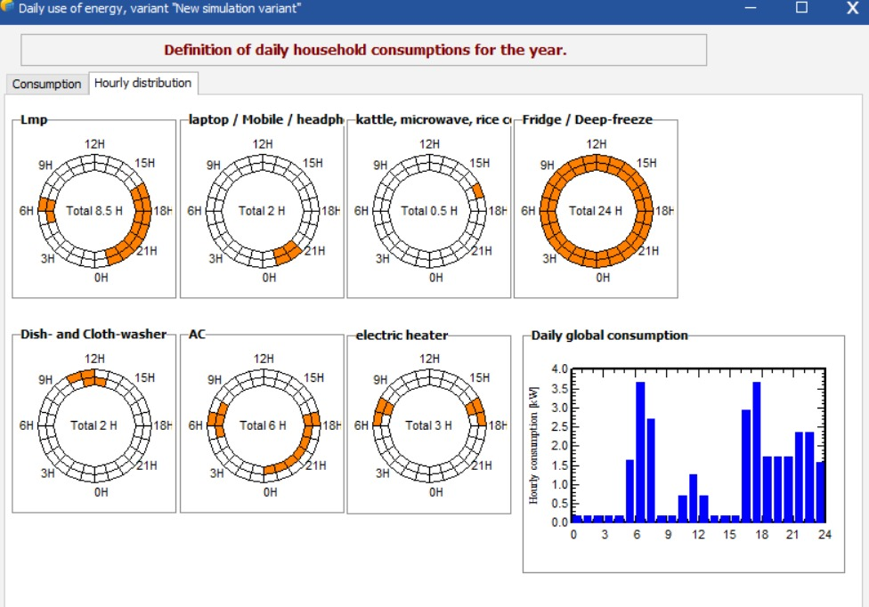
The inverter
The Load profile

Slide 13
The inverter
Appliance | No. | Surge Power (Watt) | Steady-State Power (Watt)
Fridge | 3 | 216 | 72
AC | 3 | 4500 | 1500
Washing Machine | 1 | 3300 | 1100
Microwave | 1 | 1200 | 1200
Electric Heater | 1 | 1125 | 1125
Kettle | 1 | 1100 | 1100
Lamps | 11 | – | 22
Router | 2 | – | 12
Domestic | 1 | – | 500
Chargers | 9 | – | 95
the total surge power |  | 22.494 KWatt
The Surge Power Calculation

Slide 14


Simulation on PVsyst

Slide 15
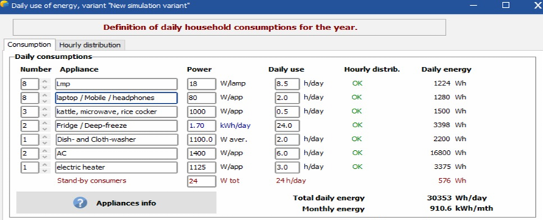
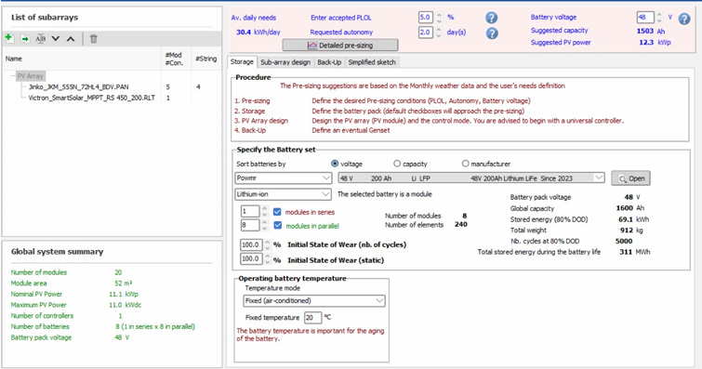
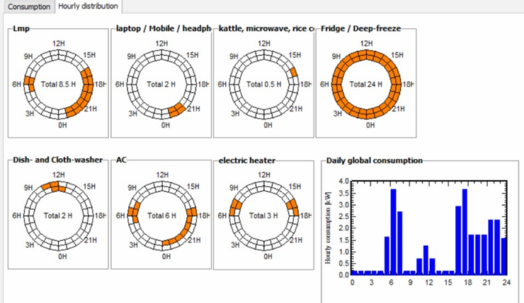
STORAGE
CONSUMPTION

Slide 16
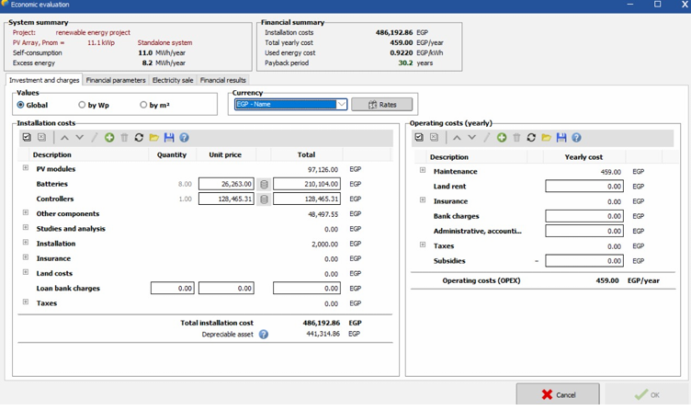
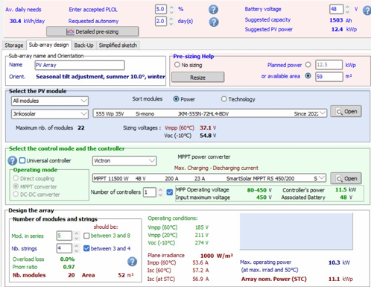
COST ANALYSIS AND PAYBACK
PV ARRAY

Slide 17
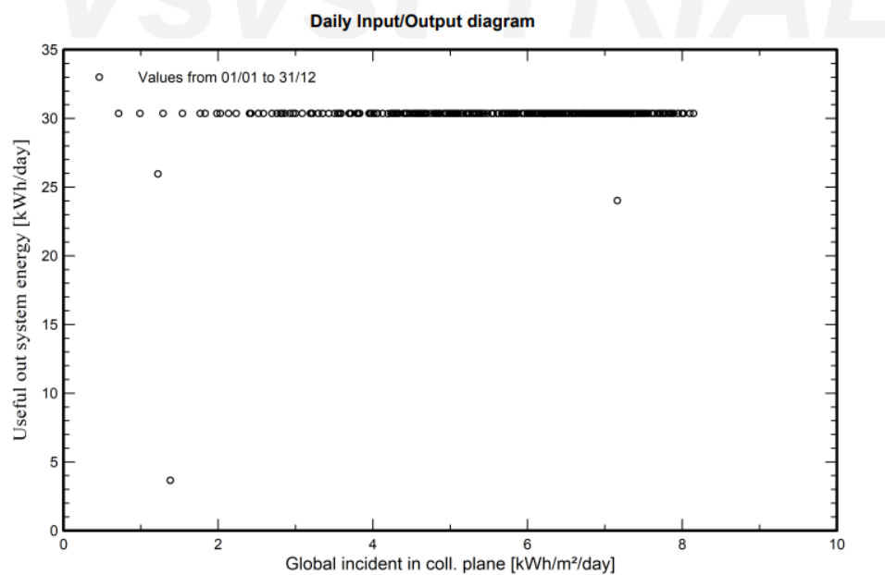
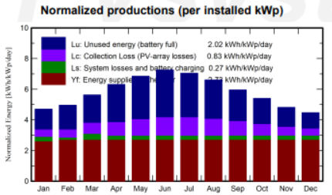
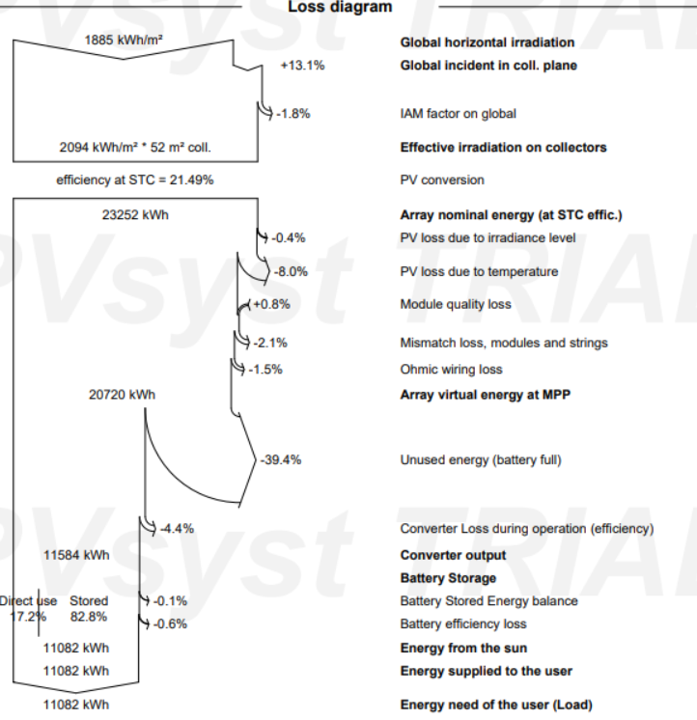
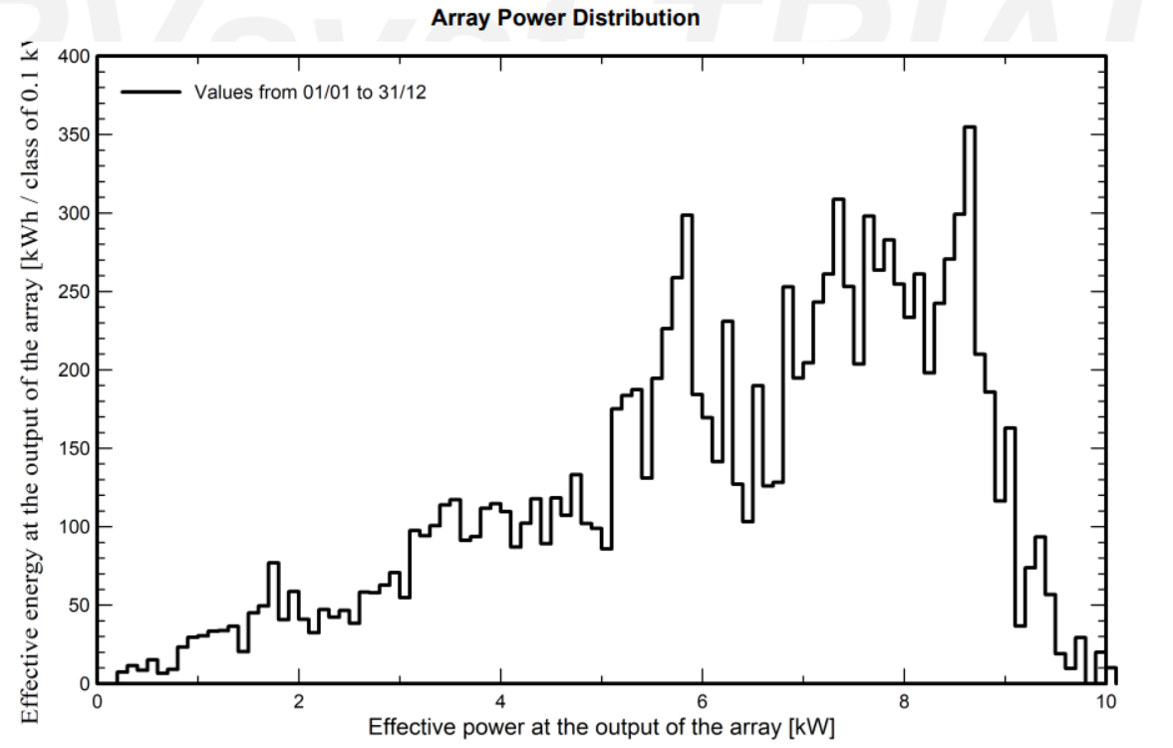
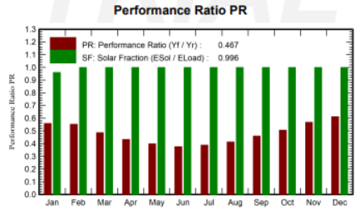
SIMULATION OUTPUTS
Used seasonal tilting
Energy supplied is nearly constant
The array operates most frequently in the 4–8 kW power range
Typical PR for real-world systems
and a near optimal solar fraction

Slide 18
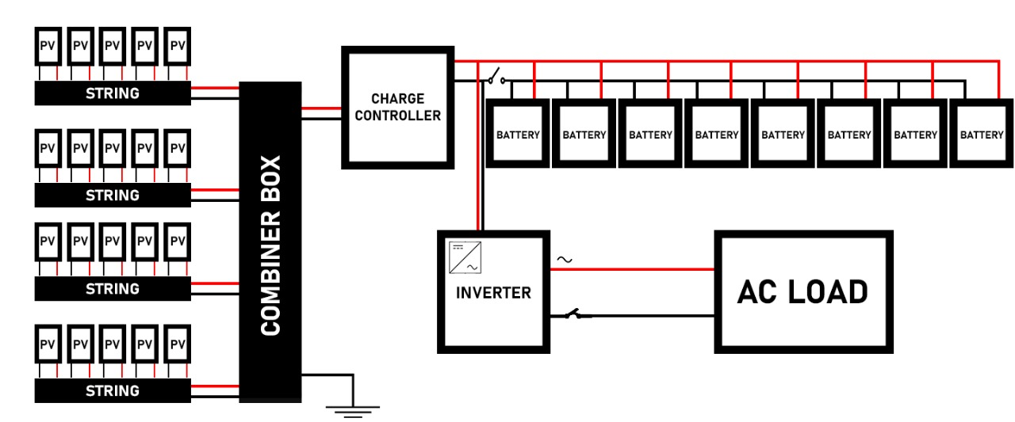

The wiring diagram

Slide 19
Cost analysis with batteries
The component | Quantity | Cost (egp) | Total cost (egp)
PV modules | 20 | 4856.25 | 97125
Batteries | 8 | 26263 | 210104
Charge controller | 1 | 76797 | 76797
Inverter | 1 | 51668.31 | 51668.31
Circuit breakers | 2 | 7234 | 14468
Switches | 2 | 9917+1580 | 22994
Surge protection | 1 | 416 | 416
Support | 1 | 5,619.55 | 5,619.55
Maintenance, installation | 1 | 16000 | 16000
Wires | 1 | 5000 | 5000
Total cost | - | - | 500236.86
The payback period | 30.5 years

Slide 20
Cost analysis without batteries
The component | Quantity | Cost (egp) | Total cost (egp)
PV modules | 20 | 4856.25 | 97125
Charge controller | 1 | 76797 | 76797
Inverter | 1 | 51668.31 | 51668.31
Circuit breakers | 2 | 7234 | 14468
Switches | 2 | 9917+1580 | 22994
Surge protection | 1 | 416 | 416
Support | 1 | 5,619.55 | 5,619.55
Maintenance, installation | 1 | 16000 | 16000
Wires | 1 | 5000 | 5000
Total cost | - | - | 290132.86
The payback period | 17.7 years

Slide 21
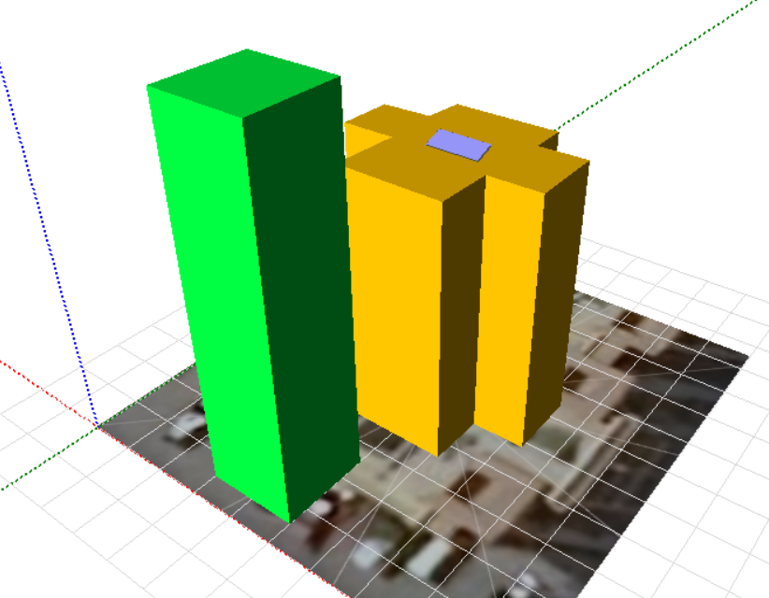
Effect of shading

Slide 22
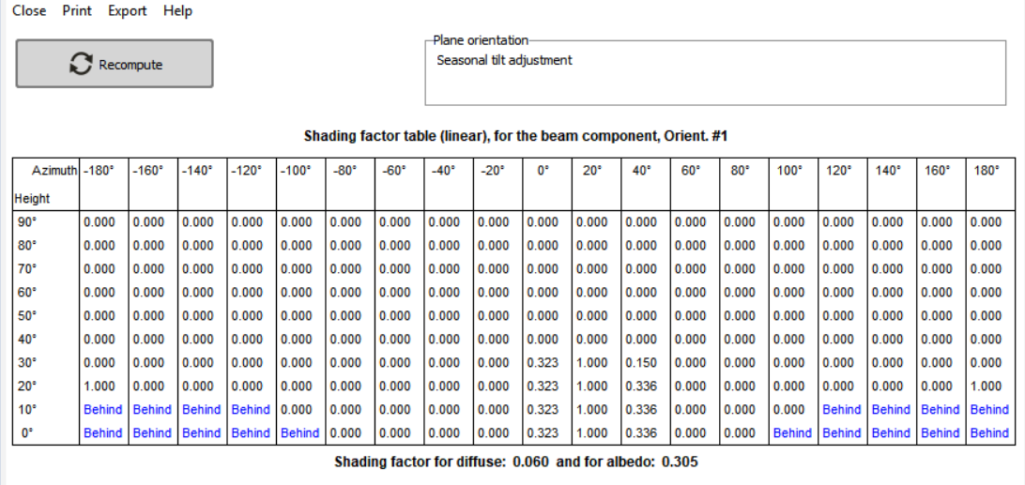
the shading factor table

Slide 23
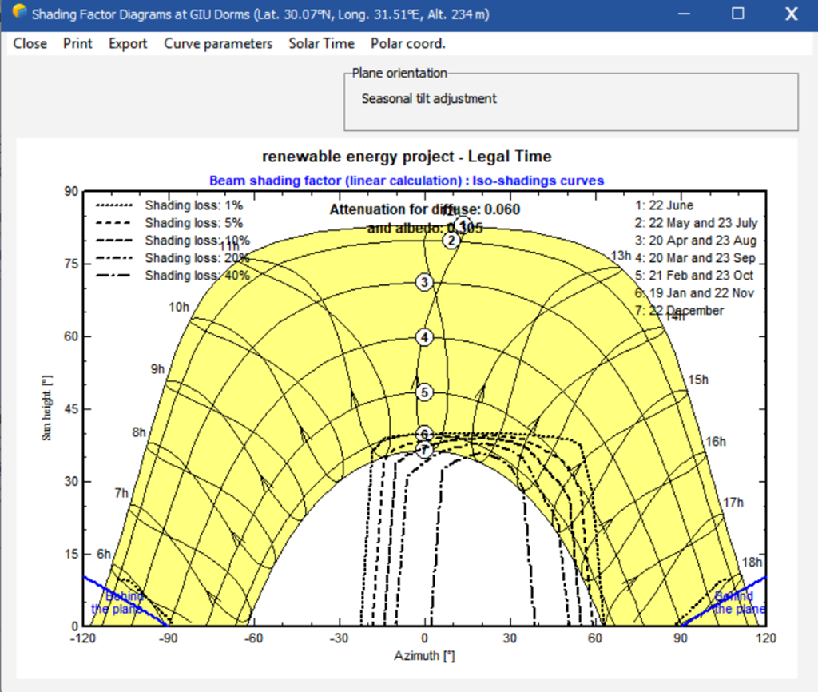

The Shading factor diagram

Slide 24



THANK YOU

